Slide 1

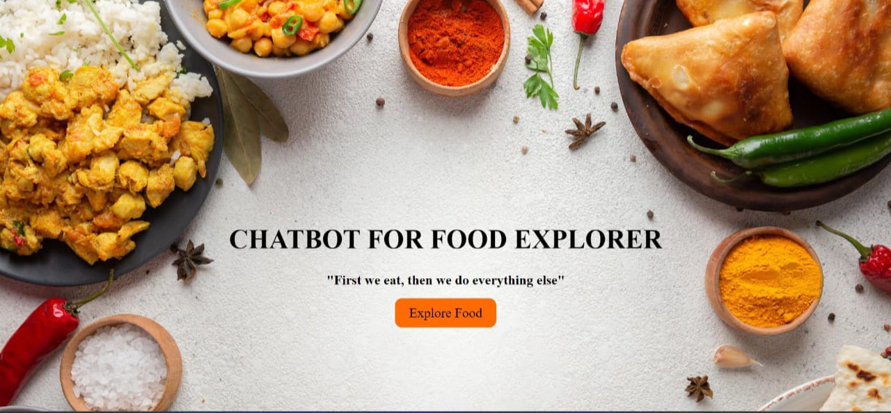
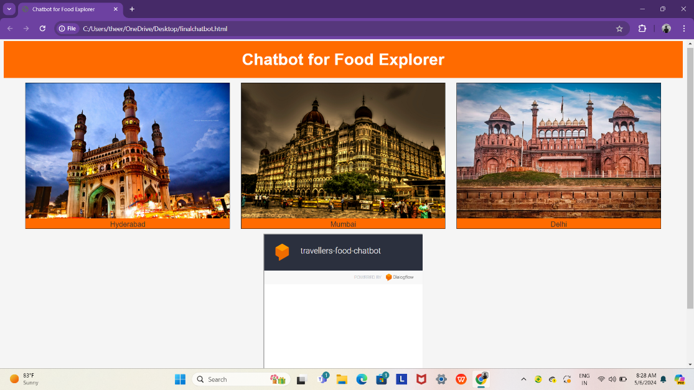
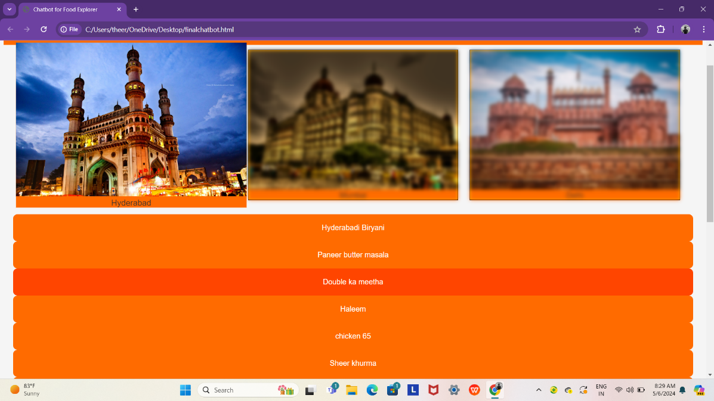
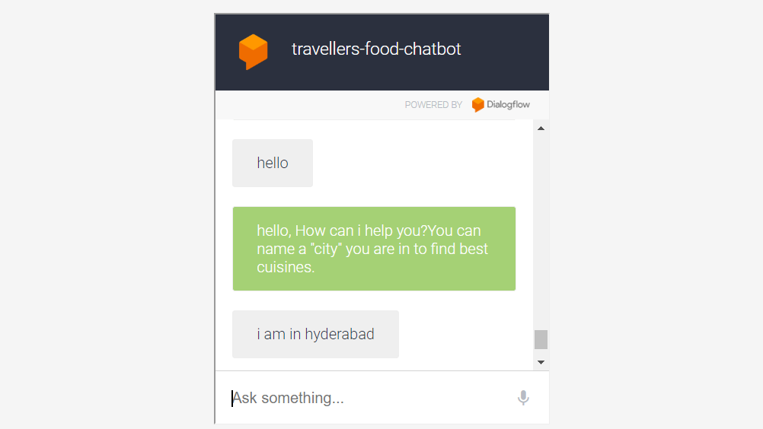
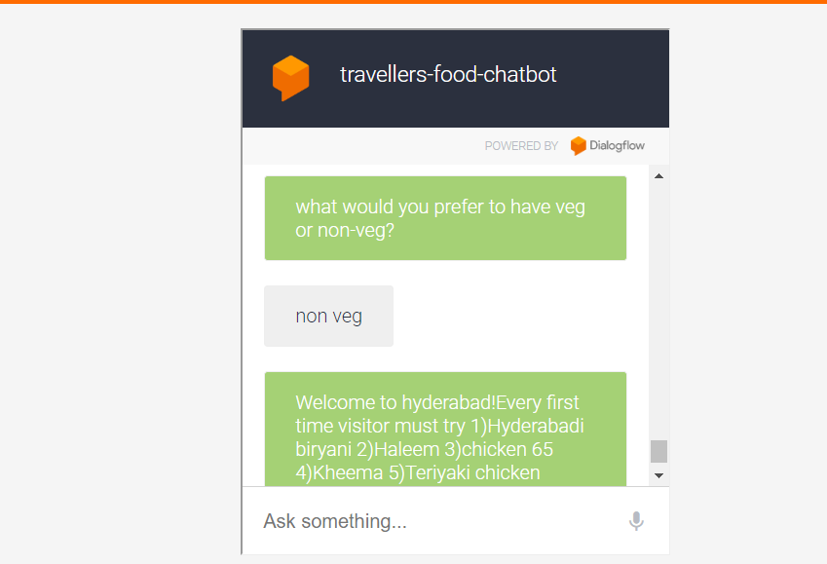
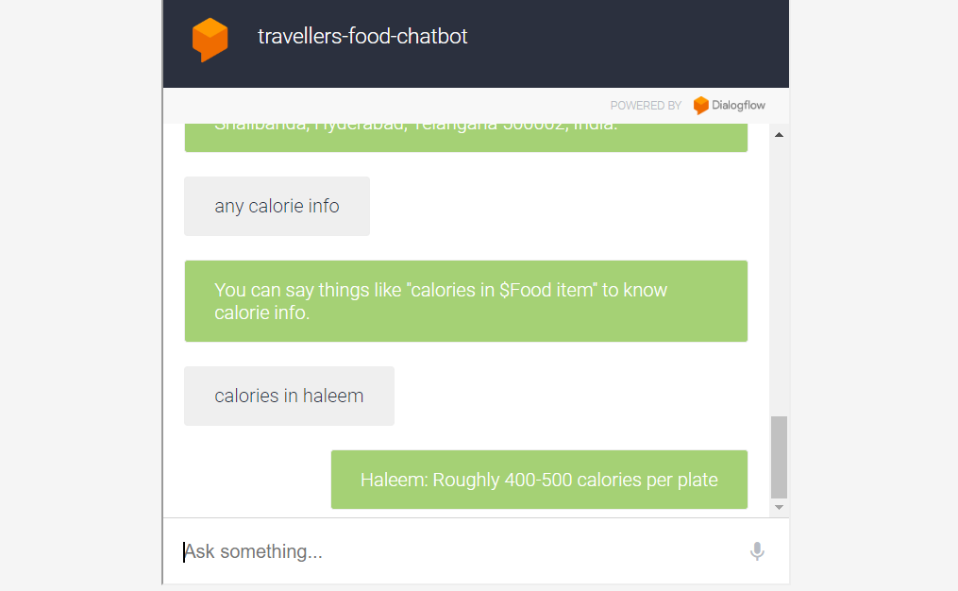
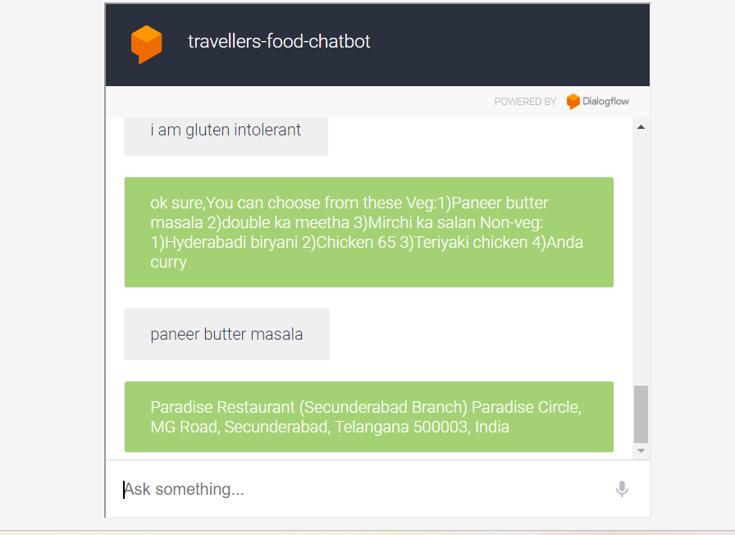
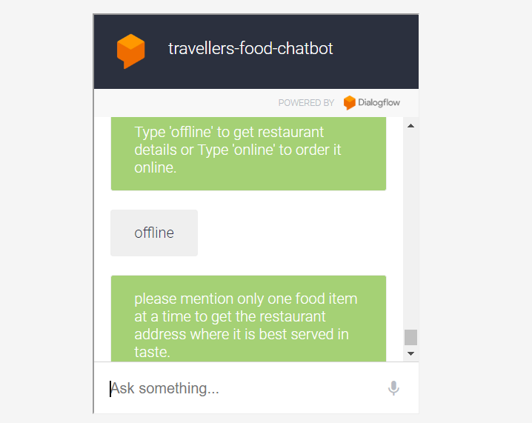
CHATBOT FOR FOOD EXPLORER
SR UNIVERSITY
TEAM-58
Guide: B.Narsimhulu sir
SRIJA: 2003A51043, NIHARIKA:2003A51060, SANKEERTH:2003A51101, MANIDEEP:2003A51027, DINESH:2103A51L32
INTRODUCTION
RESULTS
When people travel to different places or has to migrate for some work related shifts for few days, they don’t know about the food items that are authentic in that particular place, In this scenario they eat food at some random places like KFC etc. Just to let go of hunger, so in this case a chatbot can help us to find the best cuisines and authentic food this chatbot also suggest the calories of that food item.
. An allergic reaction to a specific type of food can look slightly different for everyone.so, In this case a chatbot can suggest us the food according to our preferences.
This is the front page of our project. If we click the button “explore food” it moves to next page.
OBJECTIVES
Dialog flow - Conversational Interface:
We've chosen Dialog flow as the central component of our chatbot's interface. It enables users to communicate with the chatbot through natural language, just as if they were having a conversation with a knowledgeable friend. Users can ask questions, give commands, and provide feedback in their own words. Dialog flow helps us understand what users want and respond appropriately.
End-to-End Natural Language Processing (NLP) - Understanding User Input:
End-to-end NLP plays a crucial role in our chatbot's ability to understand and respond to users. When a user asks a question or makes a request, the chatbot uses NLP to analyze the text and extract key information. For instance, it can determine the user's location, cuisine preferences, or any specific restaurant names mentioned. This deep understanding allows our chatbot to provide relevant and context-aware responses.
These are the locations available in our chatbot
1)Hyderabad
2)Mumbai
3)Delhi
By single tapping on Hyderabad it displays some food items like Biryani,Kheer- -etc. It is similar for other cities also.
CONCLUSION
Chatbot interface
In this rich landscape of food and flavor that we embark on a journey to introduce our innovative project—a chatbot designed to be your culinary companion. Our mission is simple yet profound: to provide you with a trusty, intuitive, and personalized guide for restaurant recommendations and the discovery of authentic cuisines specific to your location.
This innovative chatbot transcends the conventional boundaries of restaurant recommendation systems. Its adaptability lies not only in suggesting authentic eateries but also in recognizing and catering to individual tastes, dietary preferences, and even mood-based cravings. Through continuous learning from user interactions, it refines its suggestions, incorporating feedback to curate personalized dining experiences.
By tapping on Hyderabad it moves to the chatbot interface. Here, we can ask questions it will suggest us some responses. For example, if we type a food item named haleem it displays us the restaurant with it’s address and it also tells the calories in that specific food.
We can also order food from the chatbot itself.

